Slide 1
A GUI Developed for Intelligent Water Supply Data Visualization Challenge
1
Mahyar Aboutalebi (PhD student in Civil and Environmental Engineering Dept, Utah State University)
March 2019

Slide 2
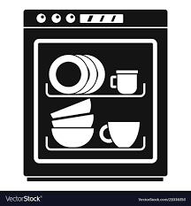





The General Idea: Signal Classification
2
We wanted to develop an APP to analyze and classify the high temporal resolution signal pulse of a single house residential water usage into the following categories:
Dishwasher, Bath, Leak, Clothes Washer, Faucet, Shower and Toilet, Outdoor Irrigation and Other.
We believe that the signal detection and classification would be more important than any information to answer “how much”, “how long” and “For what purpose” questions for water users or water providers if we want to use and highlight smart water metering data. Without classifying signals and relying solely on water usage timeseries in different time scale, providing actionable information is questionable.
Residential End Uses of Water, 2016

Slide 3
Dataset: Single Family Residential Data Platform: MATLAB
3
Why MATLAB Platform:
In the latest version of MATLAB, an efficient library has been added to analyze timeseries.
This platform can simply handle a big dataset like high-resolution single family residential data.
Besides, it has a graphical user interface (GUI) that allows users to interact with models in a user-friendly interface instead of text-based interface and typed command.
The advantage of the developed GUI:
Easily understandable
Provide actionable information.
Homeowners can execute the app for any duration that they want to see their water use visually and may change their behavior based on the information shown in this GUI.

Slide 4
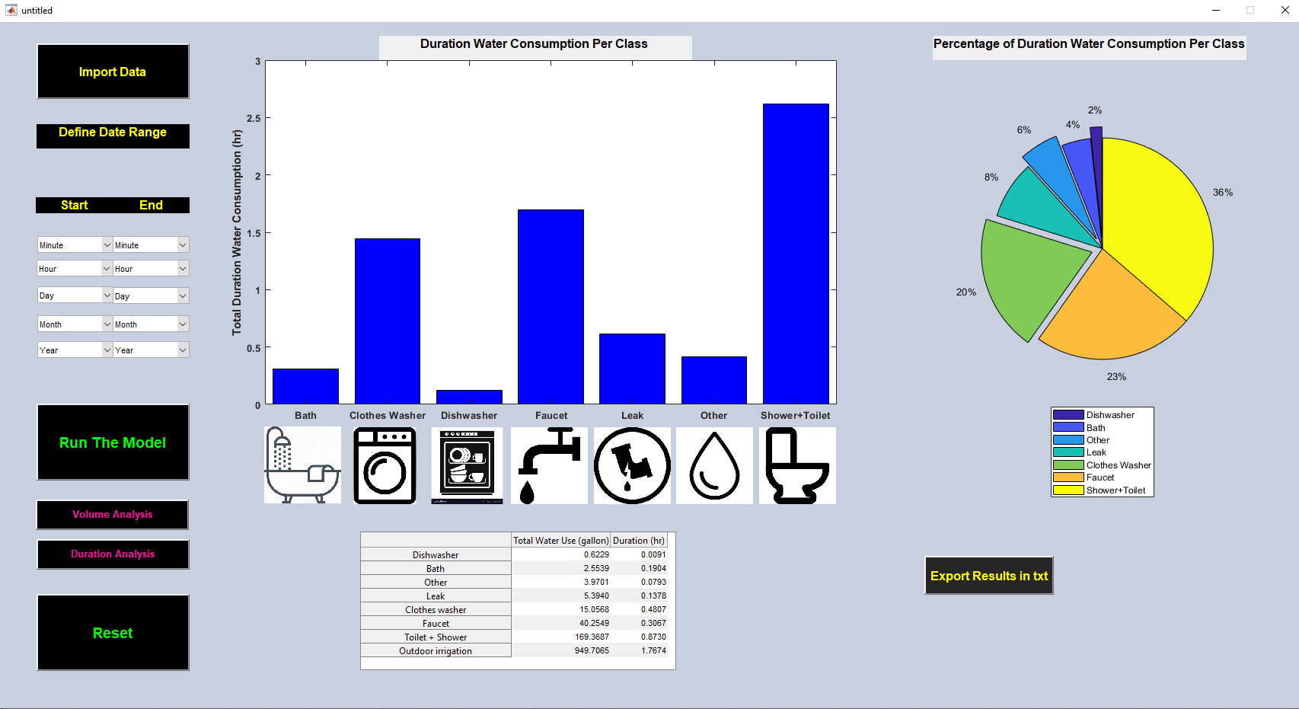
How The Model Works: Step 1: Preparation
4
As a preparation, users must
(1) import data into MATLAB software and save it in a “.mat” file.
(2) Run the “untitled.m” file to Import the .mat data using “import Data” button.
(3) Define Date Range using pop of menu
Now the model is set up to be executed.

Slide 5
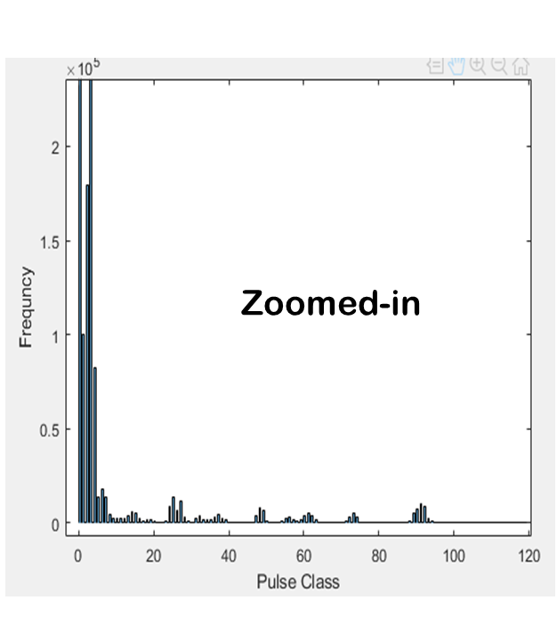
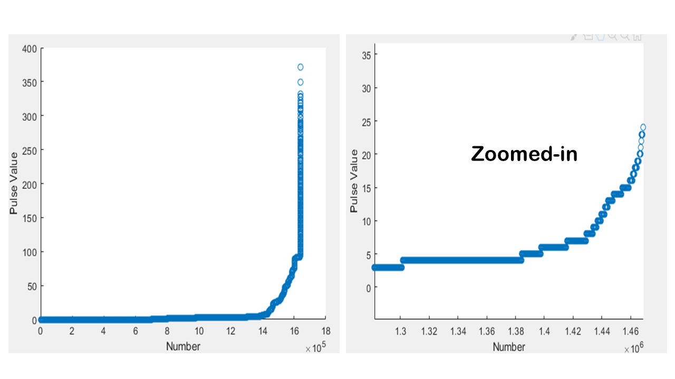
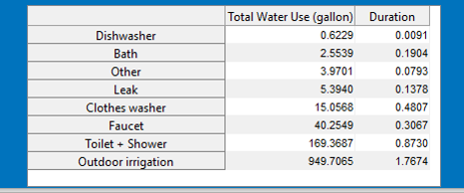
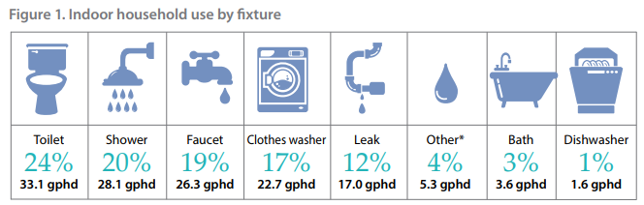
How The Model Works: Step 2: Run The Model
5
~20
classes
1
class
1
class
Convert Data to TimeTable format (A general format for timeseries analysis in MATLAB)
After preparation, users can run the model using “Run the model” button. Here is a flowchart showing how the model works:
Initial classification using initial thresholds
(Expert knowledge, Histogram Analysis, Sorting Data)
Compute Duration and Water Volume for initial classes
(Duration (second) =NpEvent*4s)
(Volume (gallon) = Npevent*0.0087)
Unsupervised classification (k-means clustering) to merge similar initial classes based on Duration and Volume and provide 8 clusters
Labeling clusters according to “Residential End Uses of Water, 2016”

Slide 6
How The Model Works: Step 3: Visualization
6
The model can visualize the data based on two features of the clusters; Volume and Duration of Total Water Use. Users can switch between these using “Volume Analysis” and “Duration Analysis” button. The model provides two charts; a bar histogram for actual values and a pie chart for relative values.

Slide 7
How The Model Works: Step 4: options
7
Users can export the result of clustering (Table in the GUI) in “.txt” file using “Export Results in txt” button and reset the GUI for other date range execution using “Reset” button.

Slide 8
Pros and Cons:
8
Pros and Cons of the Model
Cons
Pros
The results can be exported in txt file for further analysis.
Relatively it is fast (~40 seconds for 2 months data)
It is flexible to be run for any time range defined by users
Data must be imported first in MATLAB and exported in mat file
Novel Algorithm. It is not inspired
The model can estimate how much water for how long is used for 8 major sources.
It cannot estimate shower and toilet separately but It can be improved if data providers prepare a real training datasets.

Slide 9
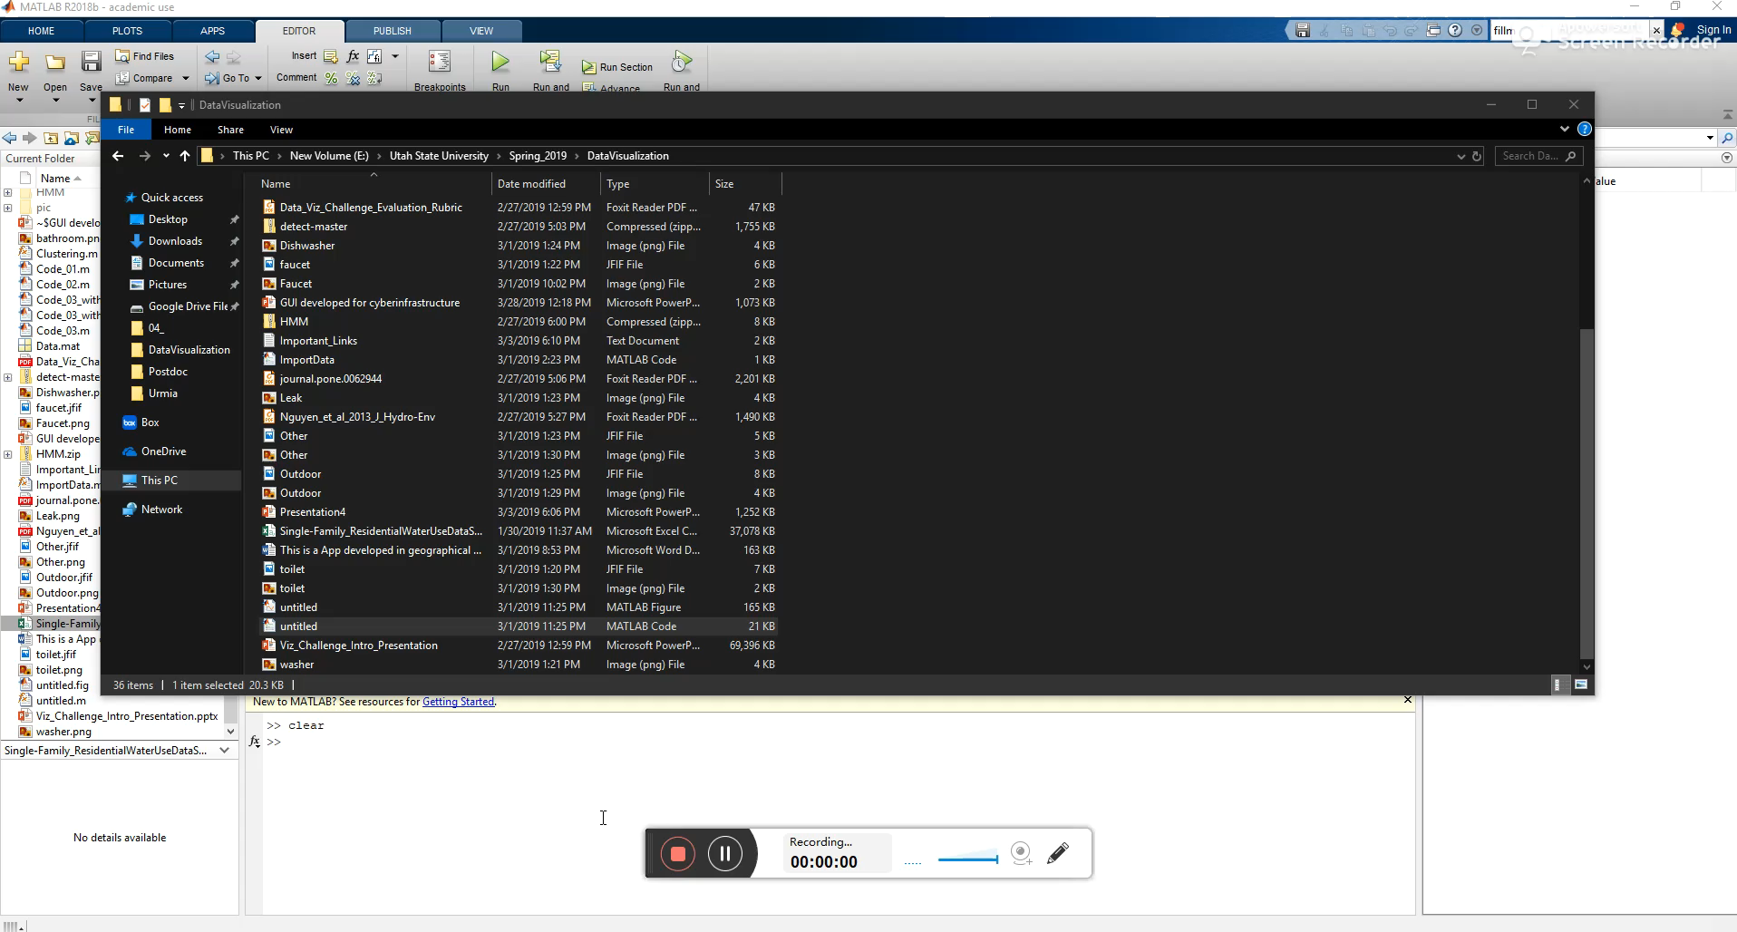
Demo
9

Slide 10


10

